Slide 1

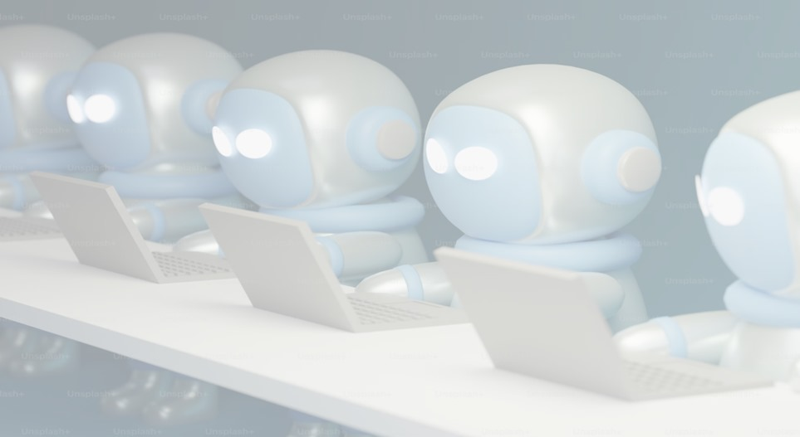
GOVBOT-A HEALTH SCHEME ASSIST GE19612 – PROFESSIONAL READINESS FOR INNOVATION, EMPLOYABILITY AND ENTREPRENEURSHIP Submitted by : janani v-2116210701087 JAYA DARSHINI V-2116210701088 KEERTHANA H-2116210701117 Supervisor : Dr . K.Anand M.E.,Ph.D., Professor Department of Computer Science and Engineering Rajalakshmi Engineering College Thandalam, Chennai-602105.

Slide 2
PROBLEM STATEMENT
The complex nature of government health policies creates a knowledge gap for individuals seeking vital healthcare resources. This results in underutilization of programs due to confusion and lack of guidance, as well as a fear of bureaucratic application processes. This project aims to bridge this gap by developing a user-friendly solution that empowers individuals to navigate the healthcare landscape with confidence.

Slide 3
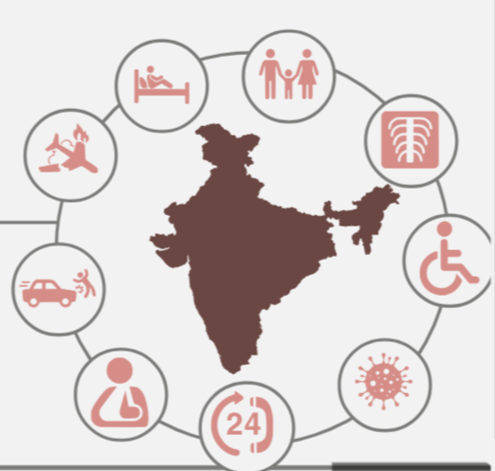
AIM AND OBJECTIVE
This project focuses on developing a user-friendly chatbot, to help individuals in navigating government health policies. It gets the information from the user regarding the type of scheme that they are looking for and recommends the relevant scheme that they can apply. Chatbot’s scope is limited to providing information but the application process has to be handled by the user in the official website by them. It includes GUI which is user-friendly. This proposed System is a GUI-enabled Chatbot hence provides offline interactions without requiring internet.

Slide 4
ABSTRACT
This project evolves around the development of a chatbot, that helps individuals to explore and understand government health policies relevant to their circumstances.
This aims to imply machine learning algorithms, by which the chatbot analyses the user inputs and provides personalized recommendations, enhancing accessibility and awareness of the supportive measures given by the government.
The development of chatbot acts as a user-friendly and informative guide, helps in assisting the individuals by identifying potential programs based on user-provided details like health conditions, explaining relevant programs like Medicare assistance options, directing users to official government and reputable health organization websites for detailed information and application process.
This project aims to empower individuals by making critical health policy information more accessible and comprehensible, ensuring they can fully benefit from the resources and support available to them.

Slide 5

Introduction
Understanding the government health policies and support programs can be a daunting task for many individuals. To address this challenge, we propose the development of an intelligent chatbot designed to assist users in exploring and comprehending health policies relevant to their specific circumstances.
As it is a GUI-enabled Chat bot it can be accessed offline regardless of network.
This project will result in a user-friendly, informative guide that helps individuals identify potential programs based on user-provided details regarding health conditions. The chatbot will offer detailed explanations of relevant programs, including Medicare, disability benefits, and financial assistance options. Ultimately, this chatbot seeks to empower individuals by making critical health policy information more accessible and understandable, ensuring that they can take full advantage of the resources and support available to them.
Ultimately, this chatbot seeks to empower individuals by making critical health policy information more accessible and understandable, ensuring that they can take full advantage of the resources and support available to them.

Slide 6
LITERATURE SURVEY
The Chatbot Management Process is a systematic approach to managing content on chatbot systems [1], drawing from the insights gained from Evatalk, the chatbot used by the Brazilian Virtual School of Government.
The objective of the project is to utilize artificial intelligence [2] to automate university inquiries via a web platform. This platform will enable students to engage with it by either writing or speaking in natural language.
Chatbots are being utilized more and more in different industries [3], including government services, with the aim of enhancing public services and cutting down on expenses.
This study investigates the influence of interactions between chatbots and customers [4],
specifically on the promotion of brands, among a sample of 312 e-commerce users who
utilize chatbot systems powered by artificial intelligence.

Slide 7
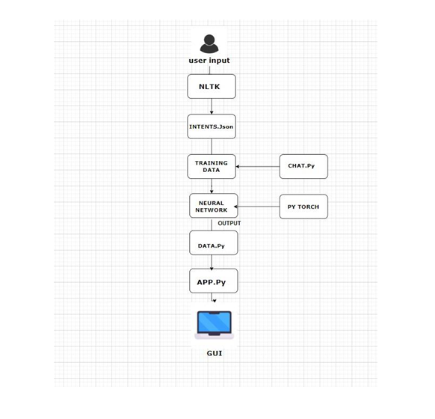
SYSTEM ARCHITECTURE

Slide 8
MODULES
NLTK MODULE: The NLTK (Natural Language Toolkit) module to performs text preprocessing tasks. It includes functions for tokenization, stemming, and creating a bag-of-words representation of text data. Tokenization breaks down sentences into individual words or tokens, while stemming reduces words to their root form.
JSON MODULE: The JSON data represents a collection of intents for a chatbot or virtual assistant. Each intent contains a tag, which serves as an identifier, a set of patterns representing user inputs or queries, and corresponding responses that the chatbot can provide
TRAINING MODULE : The training module processes intents from a JSON file, preparing data for model training using techniques like tokenization and bag-of-words. It then trains a neural network model on this data, teaching it to classify input queries and generate appropriate responses.
GUI MODULE :In app.py, a graphical user interface (GUI) is created using the Tkinter library in Python. The GUI provides a user-friendly interface for interacting with the chatbot. The main window of the application is set up with specific dimensions, title, and resizable options.

Slide 9
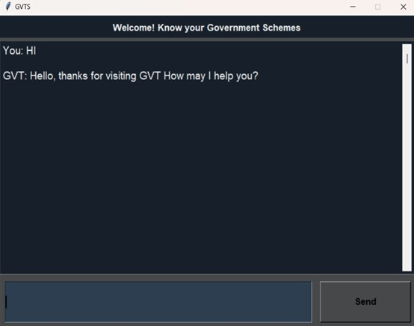
OUTPUT

Slide 10
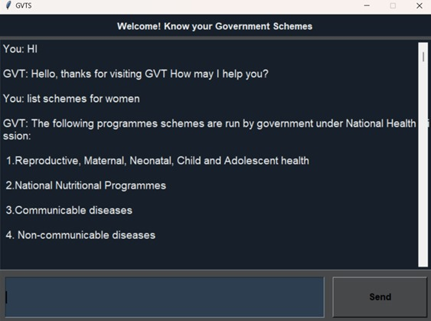
OUTPUT

Slide 11
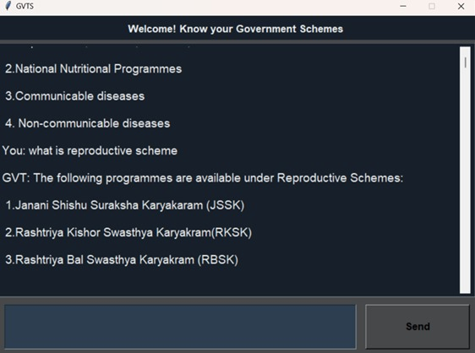
OUTPUT

Slide 12
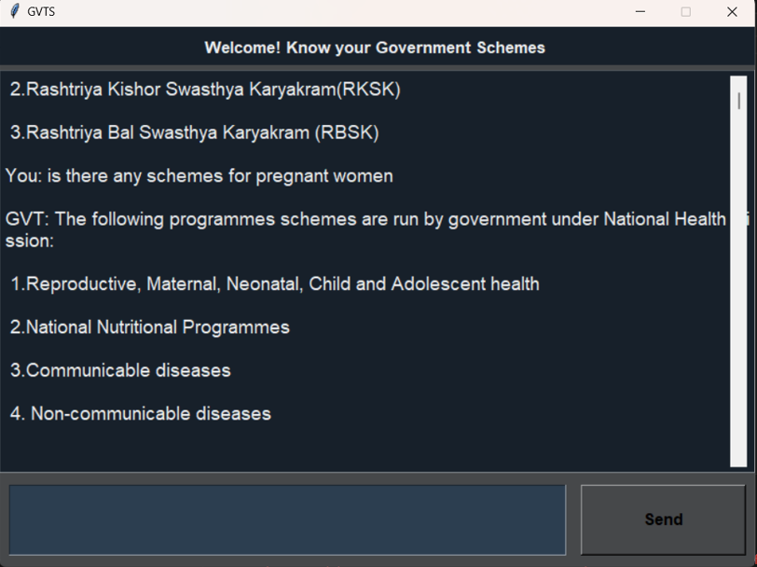
OUTPUT

Slide 13
RESULT
The proposed system is an interactive chatbot application aimed at assisting users in accessing information about various government schemes and programs. It leverages natural language processing techniques, specifically using the NLTK library for text processing and PyTorch for training a neural network model. The system begins by collecting user input, which is then tokenized and stemmed to extract meaningful information.
Intents for different user queries are defined in a JSON file, which is used for training the chatbot model. The training process involves mapping user inputs to predefined intents and responses. Once trained, the model is capable of recognizing user queries and providing appropriate responses based on the identified intent. Additionally, the application includes a graphical user interface (GUI) created using Tkinter, allowing users to interact with the chatbot seamlessly.

Slide 14
Discussions and conclusion
The proposed chatbot system represents a significant step towards enhancing accessibility to government schemes and programs. By leveraging natural language processing techniques and machine learning, the system effectively interprets user queries and provides relevant information in real-time.
The inclusion of a graphical user interface (GUI) ensures user-friendly interaction, making the system accessible to a wide range of users. Furthermore, the integration of PyTorch for training a neural network model enables accurate recognition of user intents, thereby improving the quality of responses. Overall, this system serves as a valuable tool for individuals seeking information about government initiatives, empowering them to make informed decisions and utilize available resources effectively.
As technology continues to advance, further enhancements and refinements to the system can be made, ultimately contributing to greater transparency, efficiency, and citizen engagement in governance.

Slide 15
REFERENCE
GIT HUB LINK : https://github.com/JANANI15-V/210701087-CS19621-PRIEE-/upload
G. A. Santos, G. G. de Andrade, G. R. S. Silva, F. C. M. Duarte, J. P. J. D. Costa and R. T. de Sousa, "A Conversation Driven Approach for Chatbot Management," in IEEE Access, vol. 10, pp. 8474-8486, 2022, doi: 10.1109/ACCESS.2022.3143323.
2. J. R. Caballero Castellanos, M. Cardona and J. L. Ordoñez-Avila, "Chatbot for Validation of Research Topics for Engineering Students," 2023 IEEE 41st Central America and Panama Convention (CONCAPAN XLI), Tegucigalpa, Honduras, 2023, pp. 1-5, doi: 10.1109/CONCAPANXLI59599.2023.10517536
3. R. Agra, B. G. Resende, C. C. Wermelinger, P. C. O. Dias and M. Ladeira, "A tree-organized chatbot proposal to provide a single digital channel to access specific chatbots in a real Brazilian digital government environment," 2023 18th Iberian Conference on Information Systems and Technologies (CISTI), Aveiro, Portugal, 2023, pp. 1-6, doi: 10.23919/CISTI58278.2023.10211721.

Slide 16
THANK YOU

